Slide 1
ONLINE CLASS
GRAPH THEORY
BICTE SEMESTER
2078/03/22
PRESENTED BY KALYAN DAHAL

Slide 2
Pseudo graph
If a graph G contains loops or/and multiple edges, it is called Pseudo graphs.
Labelled graph
If each vertex of a graph is given an unique name or label, it is called a labelled graph
Weighted graph
If each edge of a graph is assigned by weight, it is called a weighted graph. The weights represent the distances or time taken to travel and so on as given in the graph.

Slide 3
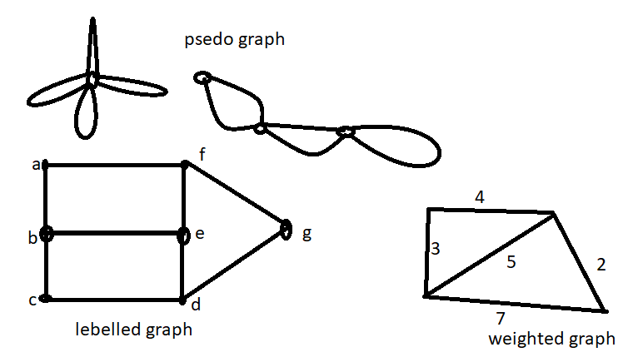
CONTINUED….

Slide 4
Walk
A walk in a graph G is a finite ordered set W = {, , , , , ..., , , } whose elements are alternatively vertices and edges such that, for 1i k, the edge has edge vertices and .
So, each edge is immediately preceded and succeeded by two vertices with which it is incident. It is clear that in a walk the vertices and edges may be repeated. In the above walk W is a – walk or walk from to . Here, the integer k, the number of edges in the walk, is called the length of W.
$e_{1}$
$e_{2}$
$e_{k}$
$v_{0}$
$v_{k}$
$v_{1}$
$v_{k−1}$

Slide 5
Path
A walk in which all the vertices are distinct, is called a path.
A walk in which all the edges are distinct, is called a trial.
Example: There are different path is given by a walk from to without repeating any vertex as given below.
Here, {}, {}, {} and {} are paths.
$v_{2}$
$v_{1}$
$v_{5}$
$v_{3}$
$v_{4}$

Slide 6
If there is a walk from any two vertices u and v of a graph G, then there is a path from these vertices alter the deletion, if necessary, of some vertices and edges.
Proof: Let us define a walk W with the help of vertices u and v of the graph G as follows u, , , ….., , , v.
Here, the walk W is a path from u to v if none of the vertices of G occurs in W more than once. It completes the proof.
So, we assume that there are vertices of G that occur in W twice or more. If so, there are distinct i, j, with i<j, such that = . If the vertices , , …., are removed from W, then we get a u – v walk () having less number of vertices than in W. If there is no repetition of vertices in then is a path from u to v. It completes the proof.
If it is not so, then we repeat the above procedure of deletion until arriving at a u – V walk, which is a required path from u to v. Hence, the theorem.

Slide 7
Closed walk:
A walk is a graph G with initial vertex and final vertex is said to be closed if = and otherwise, it is called open walk.
Circuit:
A closed trial which has at least three edges is said to be a circuit.
Cycle:
A cycle is defined as a circuit which does not repeat any vertices except the initial and final vertices.
Note: 1. A cycle is a non-intersecting circuit.
2. A cycle is of length three or more.
3. If a cycle is of length k, it is called a k-cycle.

Slide 8
The sum of the degrees of the vertices of a graph is equal to twice the number of edges.
PROOF: Let , ….., be the vertices of G and , , ……, be the non-loop edges of the graph G. since the edge {, } is incident with two vertices to , each edge contributes 2 in the degree sum. Since every loop edge is incident with twice, then every loop contributes two in degree sum.
The total number of q edges contributes 2q in the total degree of all the vertices in G.
, i = 1, 2, 3, ……, n
Hence, proved

Slide 9
The number of odd vertices in a graph is always even.
PROOF: Let a graph G contains no odd vertices then the result is obviously true.
Let the graph G contains k number of odd vertices , ….., . If G also contains even vertices , , ….., .
Then, the sum of the degrees of the graph is equal to twice the number of edges. i.e. d() + d() + …. + d() + d() + d() + …. + d() = 2q where q is total number of edges in G.
Then, d() + d() + …. + d() = 2q – (d() + d() + …. + d() ) … (i)
As the number d(), d(), …., d() are all even, their sum d() + d() + …. + d() is also even.
From (i), d() + d() + …. + d() is even. But each of the numbers d(), d(), …., d() is odd. So, k must be even. Hence, the number of odd vertices are even.

Slide 10
Adjacency matrix system
Let there are n vertices in a graph G and then the adjacency matrix of G. denoted by A(G) =is defined as
= (0) if and are disconnected
= (1) if there is a single edge joining and
= (m) if m is the number of edges joining and where m > 1.
Note:
1. denote the number of edges joining the vertices and .
2. Since, = , A(G) is a symmetric matrix.

Slide 11
Properties of adjacency matrix
All the entries belong to principal diagonal of A(G) are all o’s for a graph G. An entry of positive integer on the principal diagonal of A (G) corresponds to the number of self-loops at the vertex of the multi-graph.
The degree of a vertex equals the number of 1's in the corresponding row or column of A (G).
A graph G is disconnected and is with two components and if and only if its adjacency matrix A (G) is of the block- diagram as given below:

Slide 12
Continued….
A(G) =
Here, A () and A() are the adjacency matrices of the components and of G. The matrix A(G) clearly imply that there exists no edge joining any vertex of to .
If there is a square symmetric matrix M with order n, then it is possible to construct a multi-graph G with n vertices such that M is the adjacency matrix of G.

Slide 13
Incidence matrix system
Let there are , ….., vertices and , ….., edges in a graph (or multigraph) G then the incidence matrix of G denoted by I(G) = is defined as
=(0) if is not linked with .
= {(1) if is linked with .
= (2) if has one loop
Here, denote the number of times as the vertex is link edge .

Slide 14
Properties of incidence matrix
As every edge is linked on exactly two vertices, each column of I(G) has exactly two 1's.
The number of 1's in each row is equal to the degree of the corresponding vertex.
If there is a row with all 0's, it represents an isolated vertex.
Multiple edges in the multi-graph produce identical columns in its incidence matrix.

Slide 15
CONTINUED…
If G is disconnected has two components and , the incidence matrix I(G) of graph G is in the following form.
I(G) =
Here, I() and I() are the incidence matrices of components and of the given graph G.

Slide 16


